Slide 1
Visualizing Thumbnails of Archived Web Pages
Master’s Project
Project Advisor: Dr. Michele C. Weigle
Surbhi Shankar

Slide 2
Motivation
Mementos on a web archival collection of a particular website is difficult to access if a user has to click on the links of each of the mementos to view the archived page.
Visually representing the mementos help users easily understand the evolution of the website through time.
Thumbnails are the best way to present a web page in a visualization as a user can quickly determine the distinction in the webpages.

Slide 3
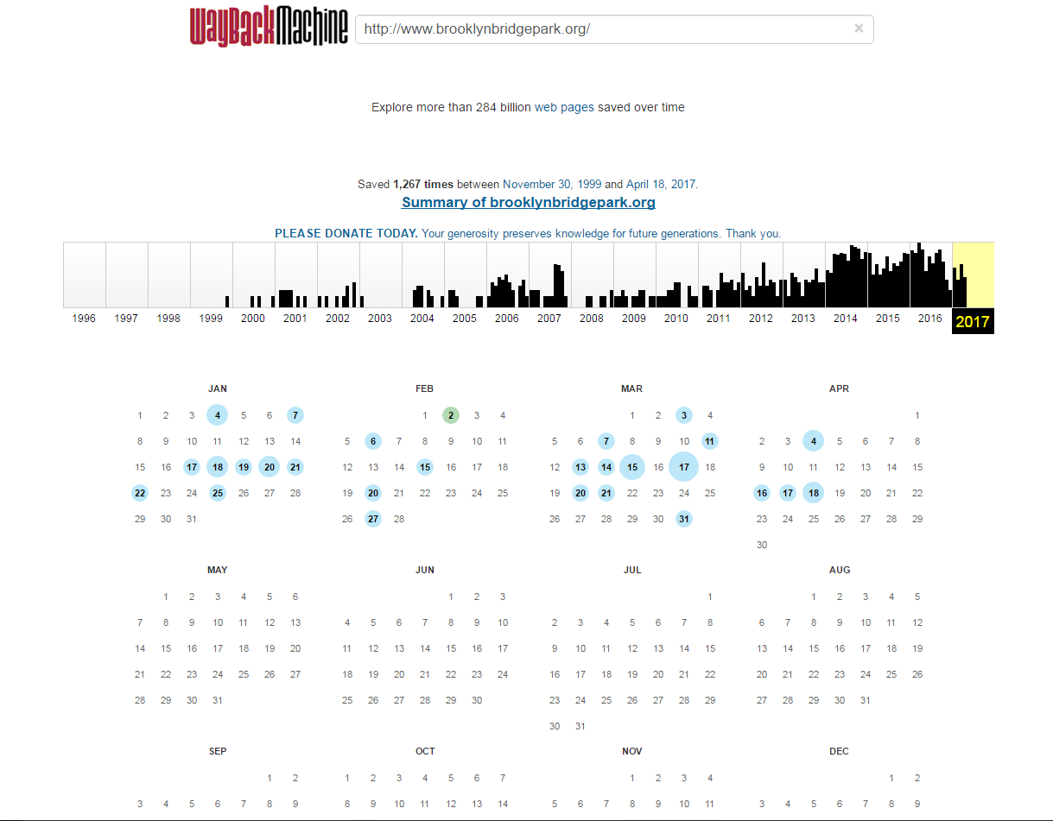
https://web.archive.org/web/*/http://www.brooklynbridgepark.org/

Slide 4
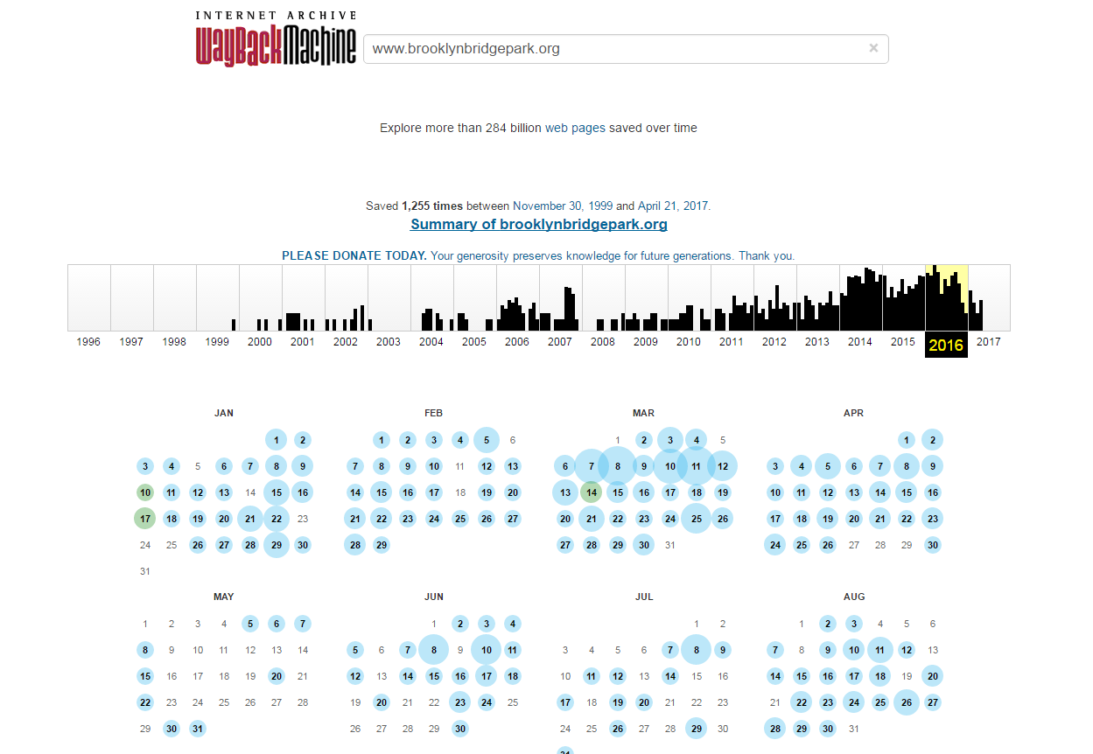
https://web.archive.org/web/20160715000000*/www.brooklynbridgepark.org

Slide 5
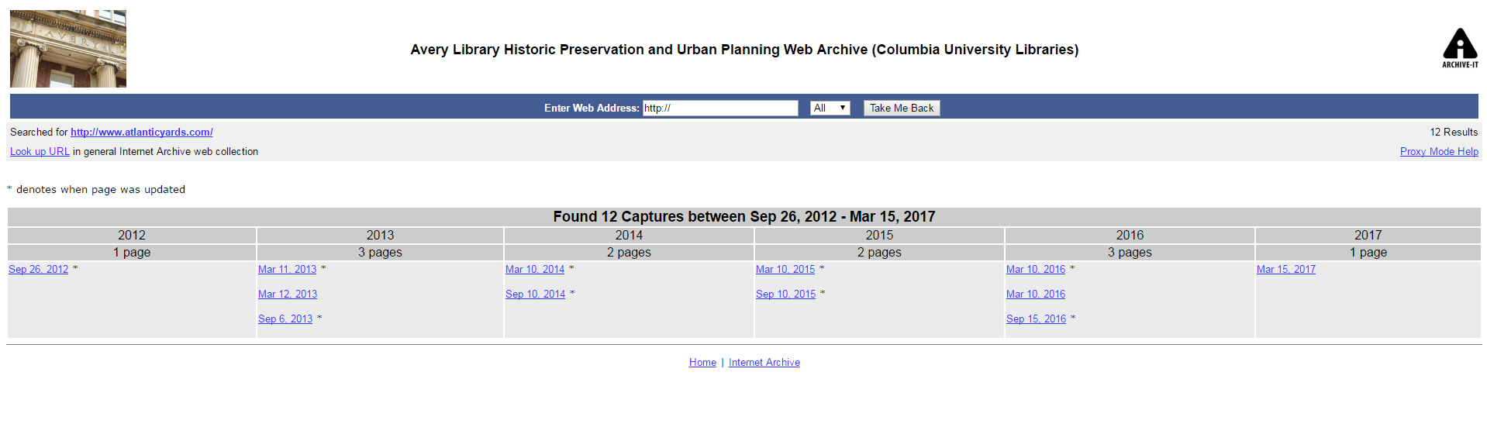
https://wayback.archive-it.org/1757/*/http://www.atlanticyards.com/

Slide 6
Archive-It Collections
New York Art Resources and Consortium (NYARC)
New York City Galleries Web Archives - https://wayback.archive-it.org/4847/*/http:/peterblumgallery.com/
Columbia University Libraries (CUL)
Human Rights Web Archive
https://wayback.archive-it.org/1068/*/http://www.cofadeh.hn/
https://wayback.archive-it.org/1068/*/http://gulflabor.org/
https://wayback.archive-it.org/1068/*/http://www.cageprisoners.com/
Avery Library Historic Preservation and Urban Planning web archive
https://wayback.archive-it.org/1757/*/http://www.atlanticyards.com/
https://wayback.archive-it.org/1757/*/http://www.brooklynbridgepark.org/

Slide 7
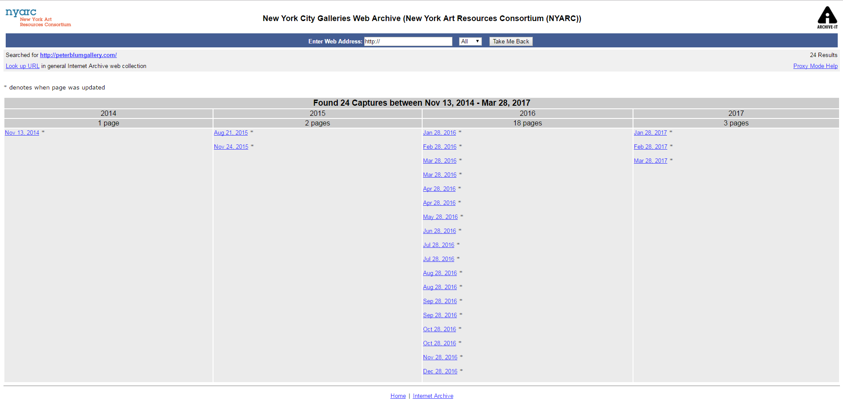
https://wayback.archive-it.org/4847/*/http:/peterblumgallery.com/

Slide 8
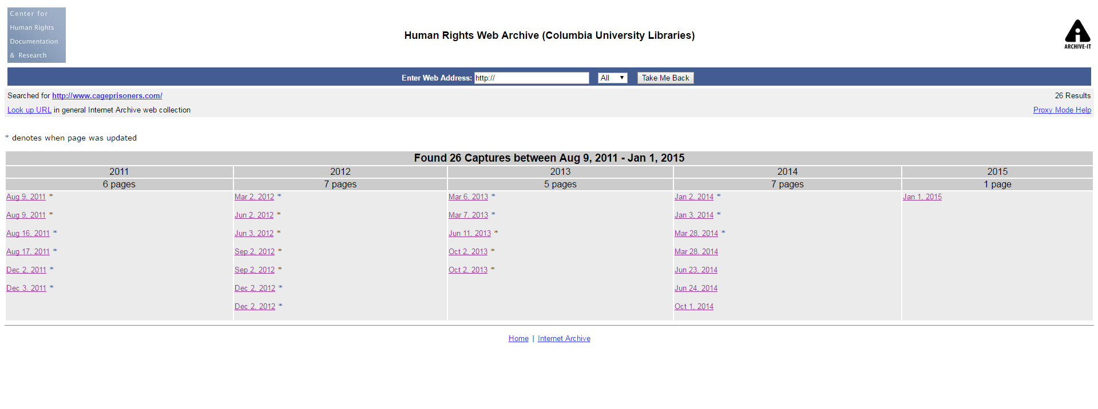
https://wayback.archive-it.org/4847/*/http:/peterblumgallery.com/

Slide 9
Data Collection
Created a python Script to create JSON files.
Example URL - https://wayback.archive-it.org/1757/20120105223347/http://www.brooklynbridgepark.org/
Two separate JSON files created, one for Timeline and the other one for Image Grid and Image Slider.
Snapshots of distinct versions of the webpages. Paths of the images also stored in the JSON file.

Slide 10
TimeMap Designs
Timeline
Interactive and the thumbnails indicate the time at which the webpage version was archived.
Two different colors are used to show the lines on the timeline which represents Thumbnails (yellow) and Non-Thumbnail Mementos (black).
Zoom-in, zoom-out, Previous and Next buttons included to make the timeline more interactive.
Information related to each webpage version is printed in the timeline-card. Also, a link to navigate to the page.

Slide 11
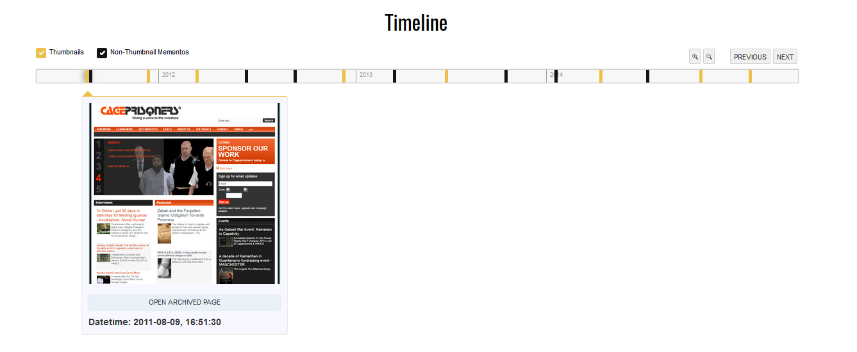

Slide 12
TimeMap Designs
Image – Slider
Single thumbnail view which includes all the snapshots of selected versions of archived webpage.
Thumbnail image changes when the cursor is moved across the image, which is similar to iPhoto image previews.
Play and Pause buttons to make it swipe over the images automatically.
Clicking on the image navigates to the webpage to the memento.

Slide 13
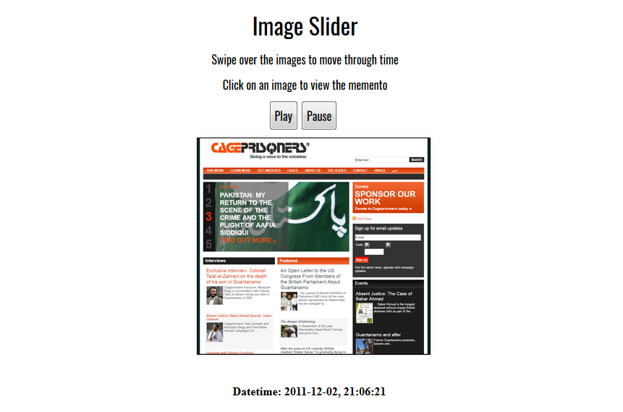
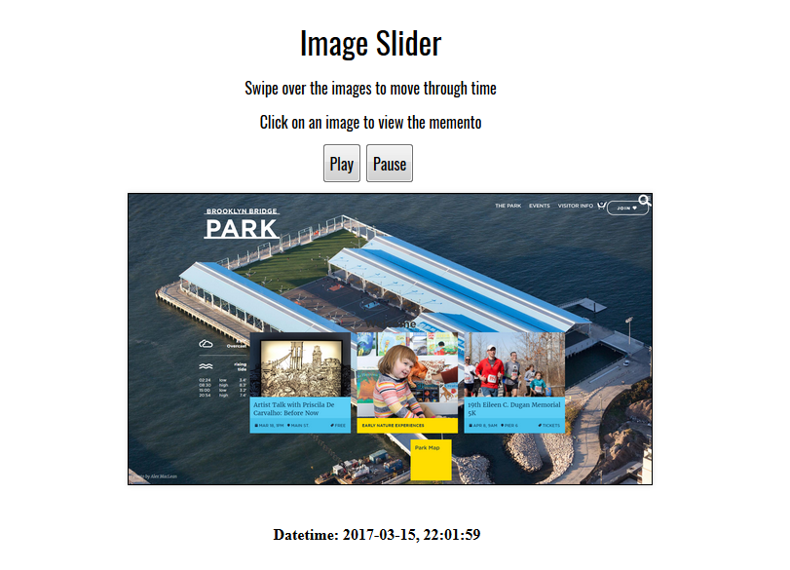

Slide 14
TimeMap Designs
Image – Grid
The goals is to show the entire thumbnail summary in a grid, this helps in comparison between each of them.
The grid is responsive so that more mementos can be added.
Clicking on the image navigates to the webpage to the memento.

Slide 15
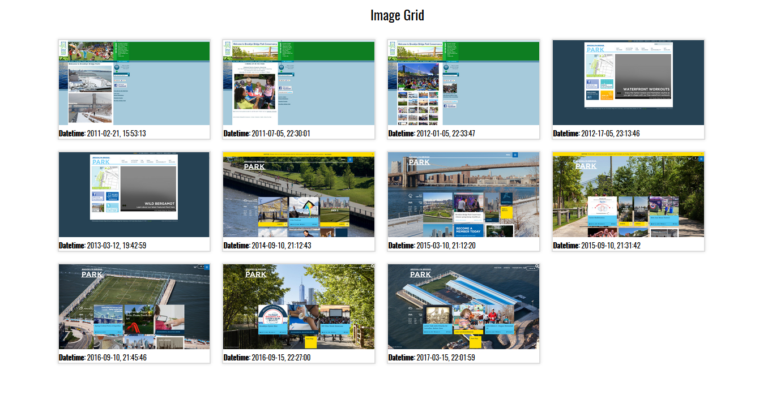

Slide 16
Challenges
Collecting data and snapshots of the webpages from each of the archived collections was very time consuming.
The concepts and algorithm in Ahmed Alsum’s “Thumbnail Summerization Techniques for Web Archives” were difficult to understand initially.
JSON files used for Timeline is different from the one used for Image Grid and Image Slider.

Slide 17
Future Enhancement
This project can be implemented alongside Thumbnail Summarization implementation.
Including filters for years for Timeline to make it more interactive. Also, displaying months and dates for zoom-in property of Timeline.
Image Grid view can be made resizable depending on the size of the thumbnail images.
Data files can be updated periodically to avoid updating the file each time new archived version of the webpage is added.

Slide 18
References
http://www.cs.odu.edu/~mweigle/Research/Timemap-Vis
https://archive-it.org/collections/4847/
https://web.archive.org/web/*/http://www.brooklynbridgepark.org/
http://thumbnails.cs.odu.edu:15421/
http://propublica.github.io/timeline-setter/
http://photoroller.martinmetodiev.com/

